Slide 1
ELECTVIZ
Infosys Springboard Data Visualization Internship 6.0
BATCH 11 , GROUP 1
By
Diksha Palliwal,
Batch 11, Team A
Mentor
Nityashri S. J.
Election Data Visualization for Media

Slide 2
Introduction
ElectViz is an interactive Power BI dashboard designed to analyze Indian election data across multiple years.
It provides insights into party performance, voter turnout, candidate demographics, gender distribution, and election trends at national and state levels.
Using dynamic filters and visualizations, this dashboard helps in understanding voting patterns, electoral strength of parties, and key factors influencing election outcomes in a simple and data-driven way.

Slide 3
Milestones
🔹 Milestone 1 – Data Preparation Data collection, cleaning, preprocessing & feature engineering (Vote Share %, Winning Margin %, Age Groups).
🔹 Milestone 2 – Modelling & Dashboards (Pg 1–3) Data modelling, DAX measures, and development of Overview, Party Performance & Gender Analysis dashboards.
🔹 Milestone 3 – Advanced Analytics (Pg 4–5) Electability analysis, trend analysis, close contest rate & party momentum insights.
🔹 Milestone 4 – Outcome & Deployment (Pg 6–7) Winning factor analysis, decision support insights, GitHub/GitLab deployment & milestone reports.

Slide 4
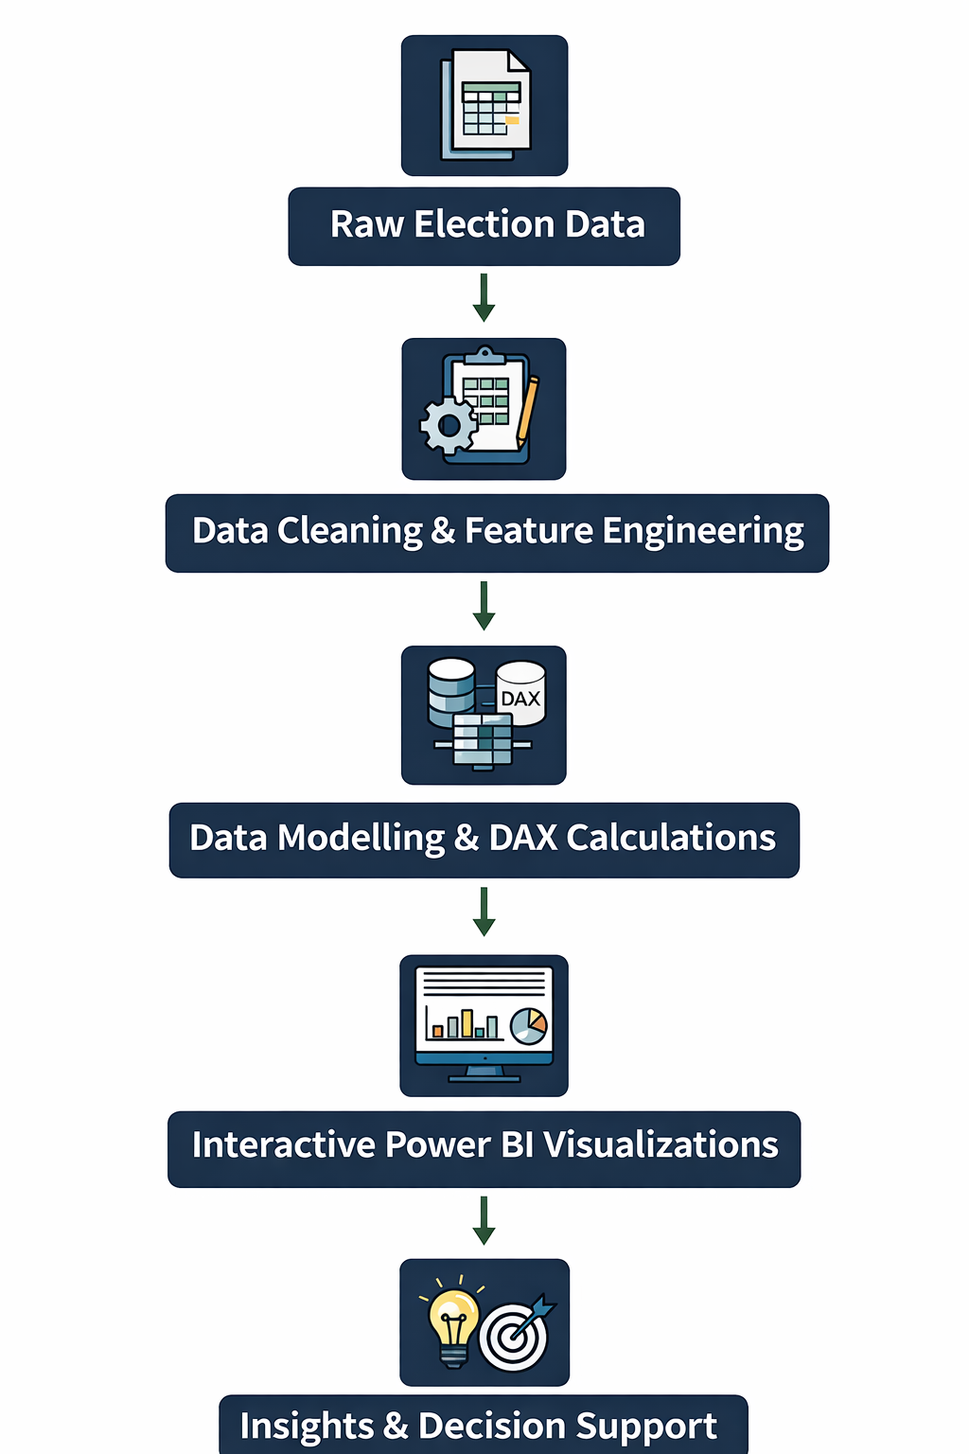
System Design – High Level Architecture
Infosys Springboard Data Visualization Internship 6.0 PPT
By
Diksha Palliwal,
Batch 11, Team A
Mentor
Nityashri S. J.
Data Sources Election datasets (CSV / Excel / Database)
Data Processing (Data Science Layer) Data cleaning, transformation, and feature engineering (vote share, turnout %, margins, age groups)
Data Modeling Fact–Dimension (Star Schema) model Enables fast aggregation and filtering
Visualization Tool Power BI for interactive dashboards and analytics

Slide 5
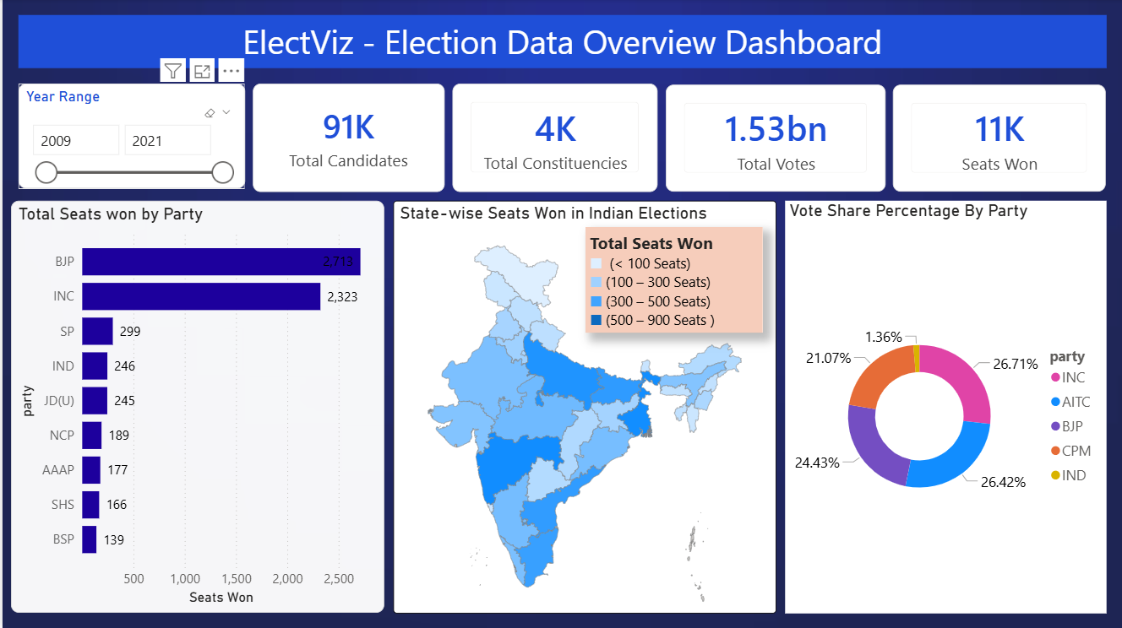
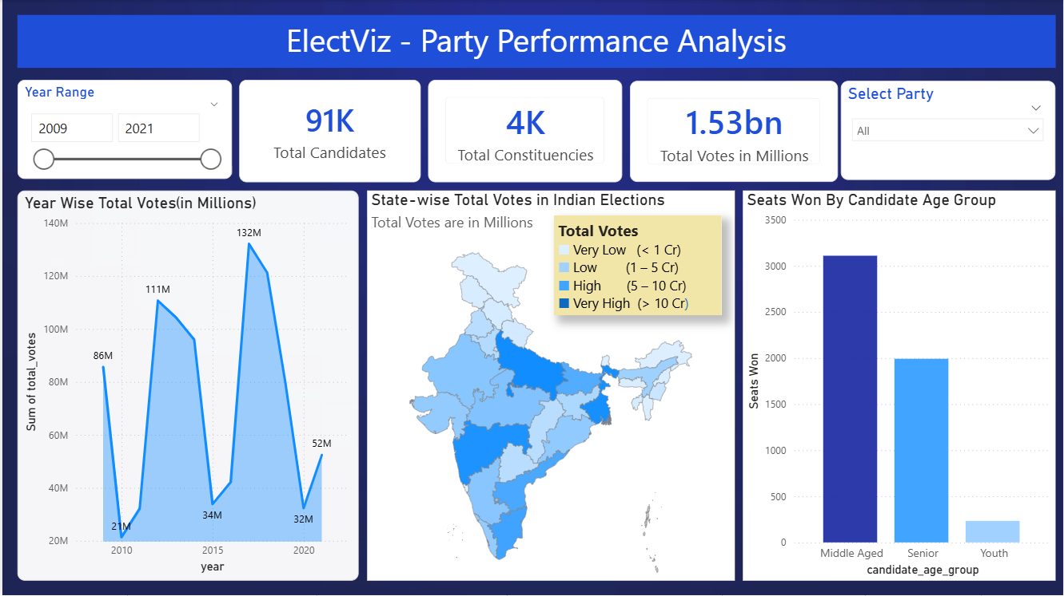
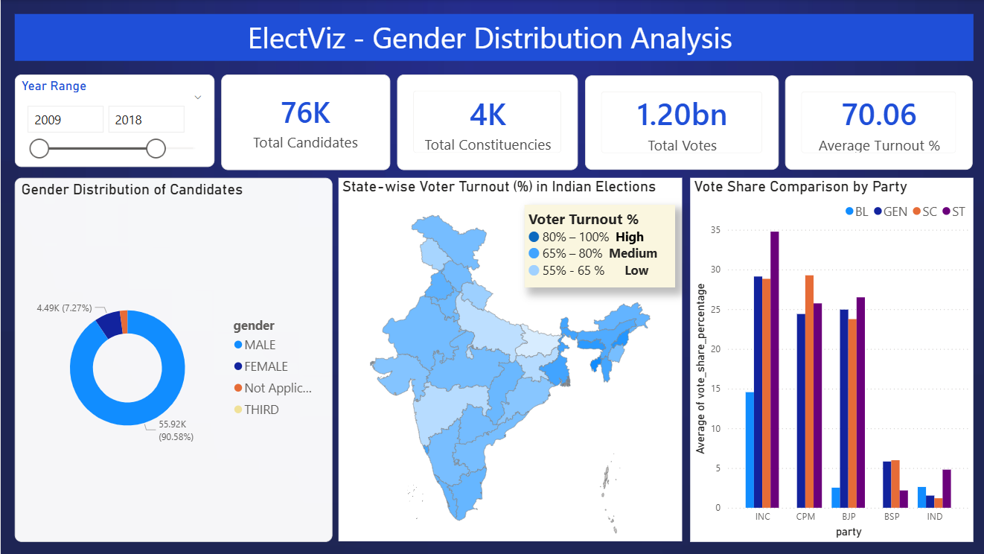
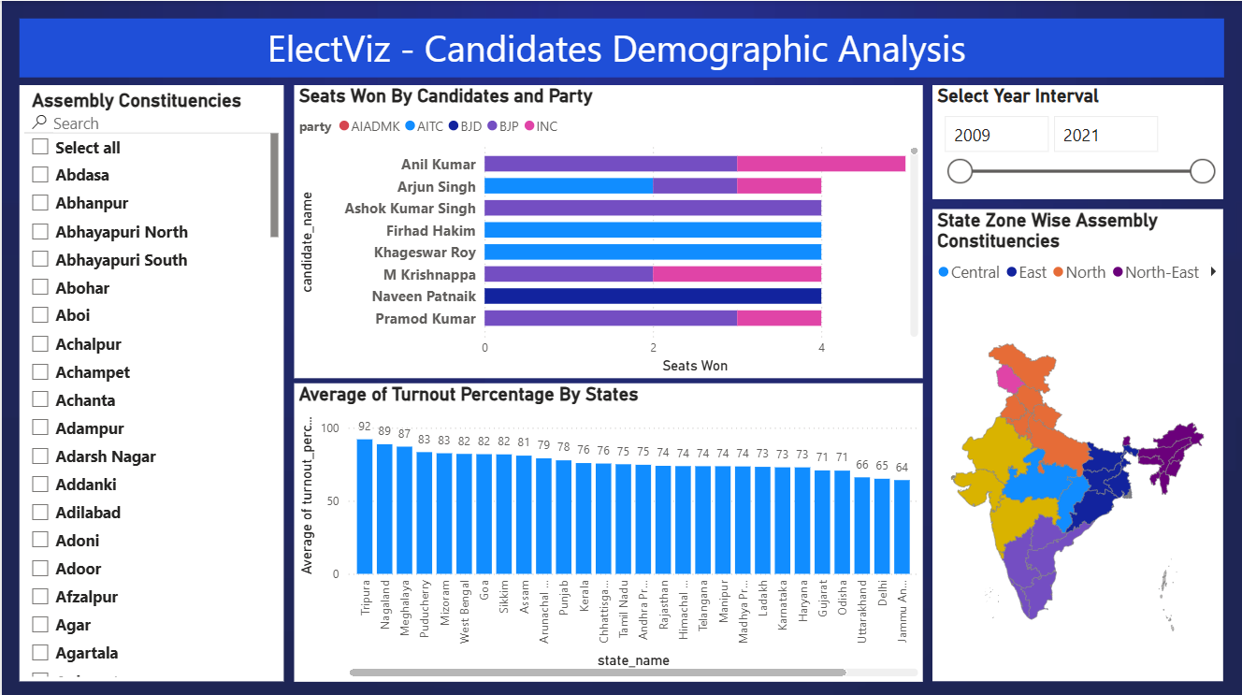
SNAPSHOTS

Slide 6
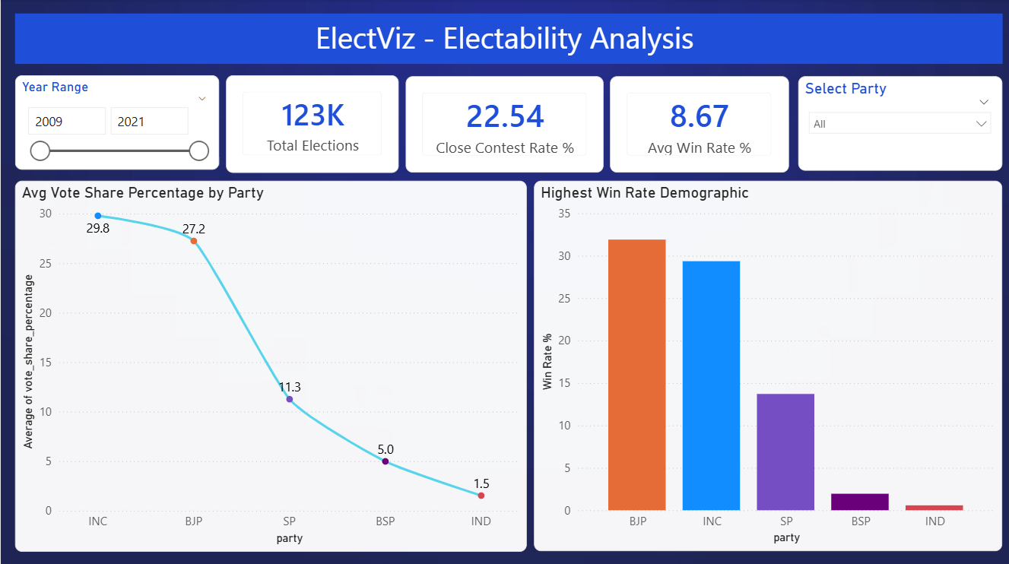
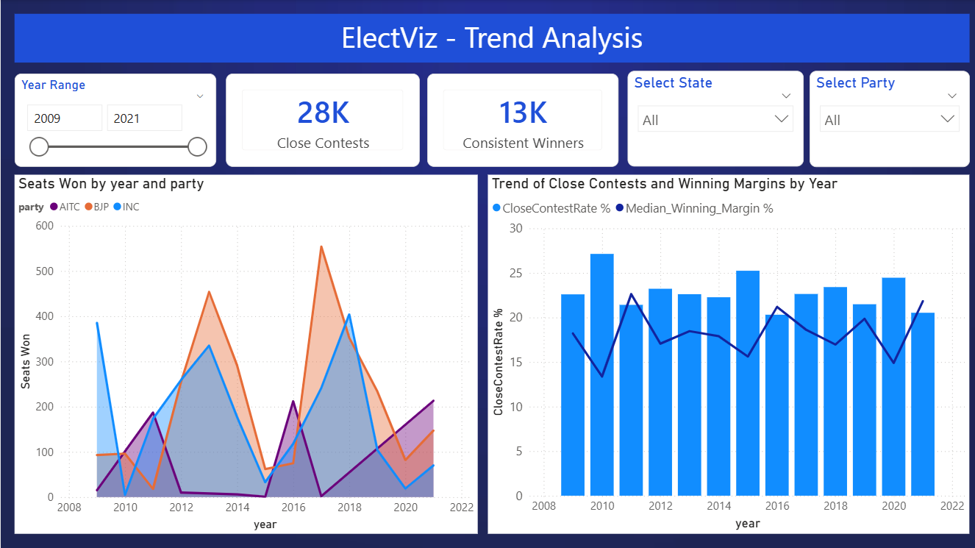
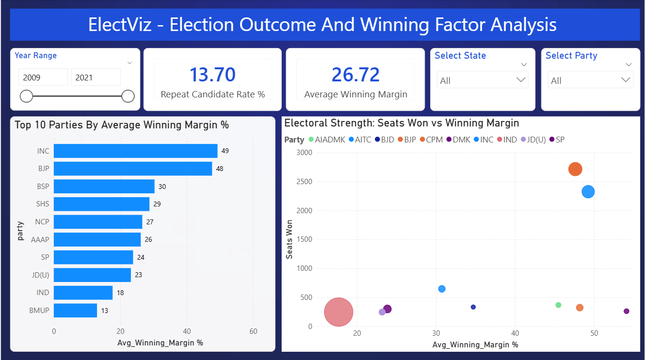
SNAPSHOTS

Slide 7
Key Insights Gained – ElectViz Dashboard
Identified major political parties’ performance trends across multiple election years
Observed significant variations in voter turnout across states and regions
Analyzed vote share distribution to understand party dominance and competition
Found demographic patterns such as age and gender influencing election outcomes
Detected closely contested constituencies using winning margin analysis
Highlighted regional strongholds and weak zones for major parties
Revealed long-term electoral trends through year-wise comparative analysis

Slide 8
Future Enhancements
Real-time Data Integration Connect live election APIs for real-time result updates
Predictive Analytics Use machine learning models to forecast election outcomes and voter turnout
Sentiment Analysis Integrate social media and news sentiment to analyze public opinion trends
Advanced Drill-Downs Enable constituency-level and booth-level analysis for deeper insights
Geospatial Enhancements Add heatmaps and spatial clustering for regional voting patterns

Slide 9
Conclusion
ElectViz successfully transforms raw election data into meaningful insights using data science and visualization techniques.
The dashboard enables clear analysis of party performance, voter behavior, and electoral trends across regions and years.
Interactive Power BI visuals make complex data easy to explore and understand.
This project demonstrates the effective use of data preprocessing, analytical modeling, and visual storytelling for decision support.
ElectViz can be further enhanced with predictive analytics and real-time data to support advanced electoral analysis.

Slide 10
Acknowledgment & References
We sincerely thank the Infosys Springboard Team for organizing this valuable internship opportunity. We are grateful to our mentor for her continuous guidance and support, and to our teammates for their collaboration and encouragement.
This internship has been an important step in our professional and technical growth.
References
Election Commission of India (ECI) statistical reports on general elections (2009–2021).
Infosys Springboard data visualization internship 6.0 – learning resources and project guidelines.
Microsoft Learn DAX (Data Analysis Expressions) reference guide.
Power Query documentation – Microsoft Learn.

Slide 11
Thankyou

